Slide 1


SUPERVISED LEARNING
Learning from Labeled Data
Predicting from Examples
📈 Regression | 📊 Classification
Linear Regression, Logistic, Trees, SVM, KNN, Forests, Naive Bayes
LEARN
APPLY
MASTER

Slide 2
Overview of the Algorithms
Linear Regression
y=mx+b | House prices, continuous
Logistic Regression
Sigmoid | Spam, binary classification
Decision Trees
Rules | Loan approval, interpretable
SVM
Kernels | Image recognition, complex boundaries
KNN
Neighbors | Recommendations, simple
Random Forest
Ensemble | Fraud, robust & fast
Naive Bayes
Probabilistic | Email, text classification

Slide 3
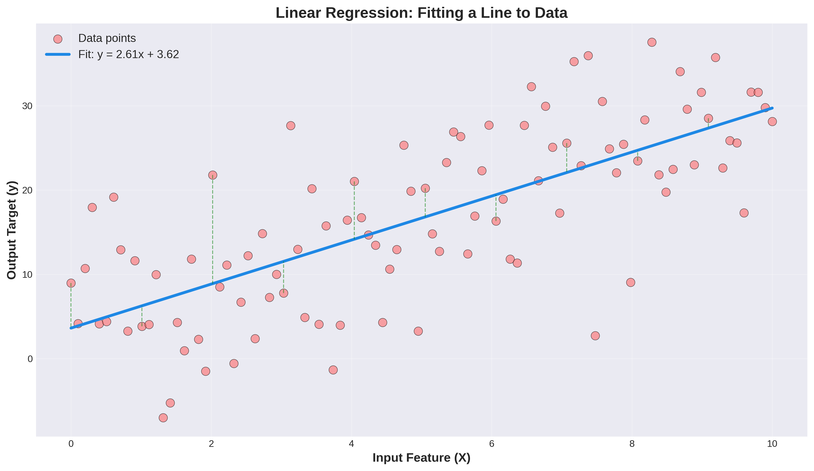
1. Linear Regression - Visual

Slide 4
1. Linear Regression - Applications
Real Use Cases
• Zillow, Redfin (real estate)
• Stock price prediction
• Demand forecasting
• Climate modeling
• Medical dosage calc
Pros & Cons
✓ Very fast
✓ Interpretable
✓ Simple baseline
✗ Linear only
✗ Poor for complex data

Slide 5
1. Linear Regression - Summary
Formula: y = mx + b (straight line)
Output: Continuous numbers
Speed: Very fast (milliseconds)
Interpretability: Very high (see coefficients)
Best For: Continuous + linear data
Avoid When: Non-linear relationships
Code: from sklearn.linear_model import LinearRegression

Slide 6
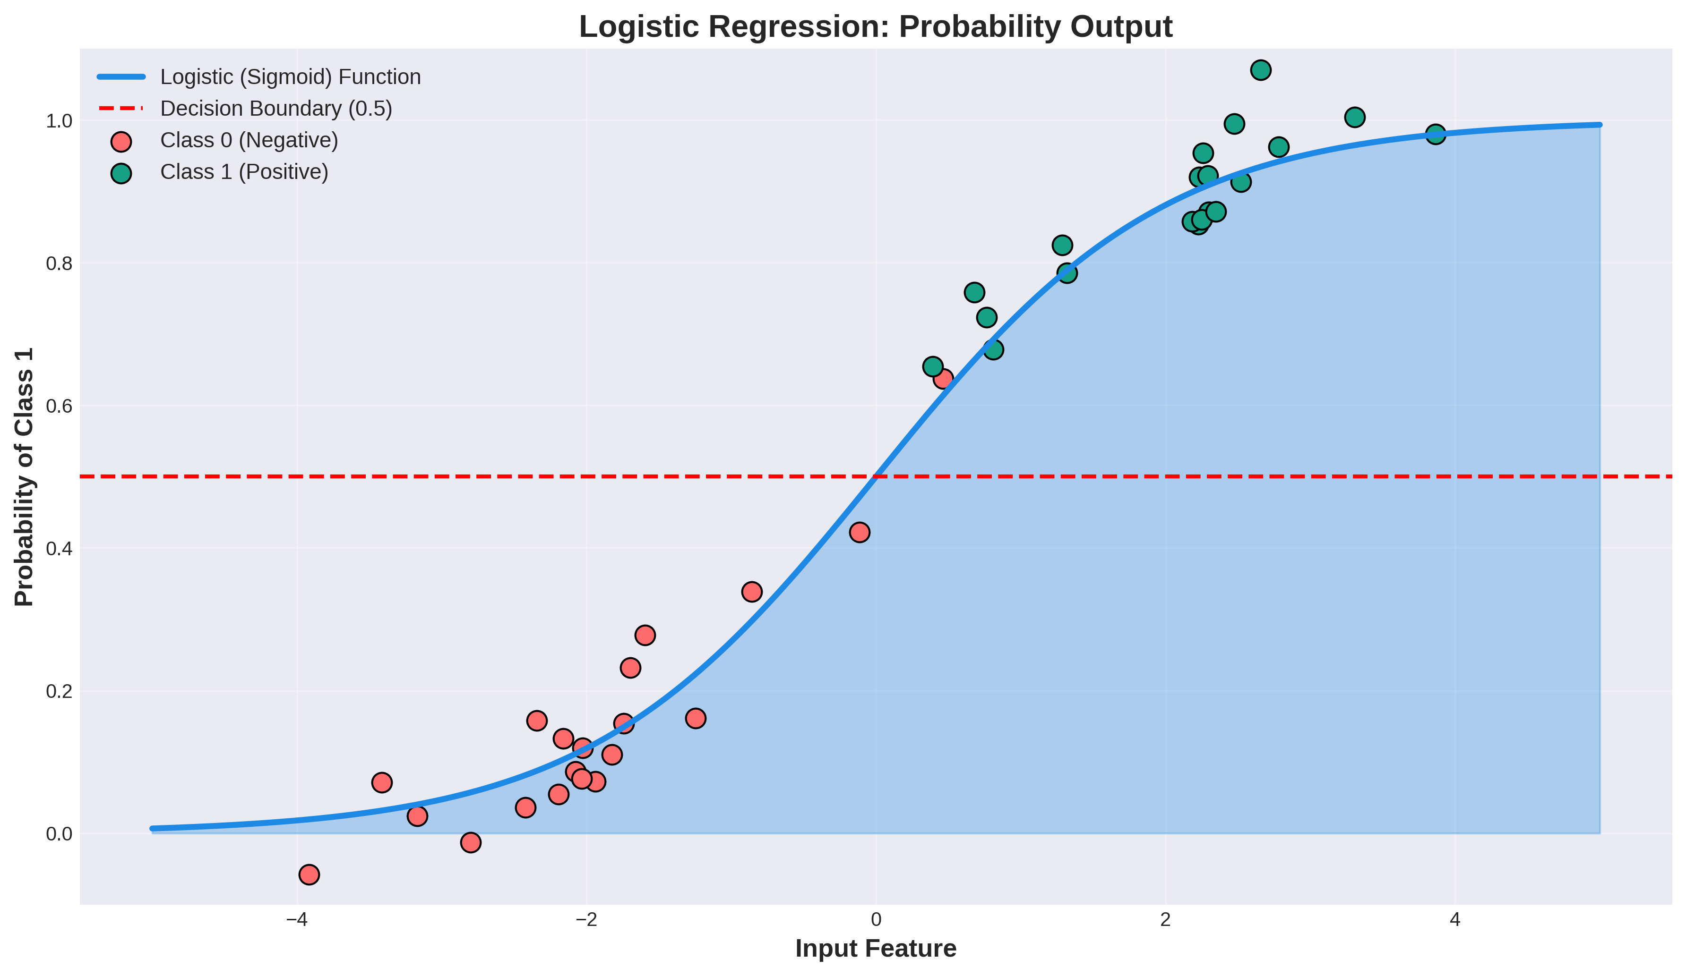
2. Logistic Regression - Visual

Slide 7
2. Logistic Regression - Applications
Real Use Cases
• Gmail spam detection
• Medical diagnosis
• Fraud detection
• Loan approval
• Customer churn
Pros & Cons
✓ Probability output
✓ Fast inference
✓ Interpretable
✗ Binary only
✗ Linear boundaries

Slide 8
2. Logistic Regression - Summary
Function: Sigmoid: P = 1/(1+e^(-z))
Output: Probability (0 to 1)
Threshold: 0.5 for binary decision
Speed: Very fast
Best For: Binary + probabilities
Avoid When: Multiclass (needs modification)
Code: from sklearn.linear_model import LogisticRegression

Slide 9
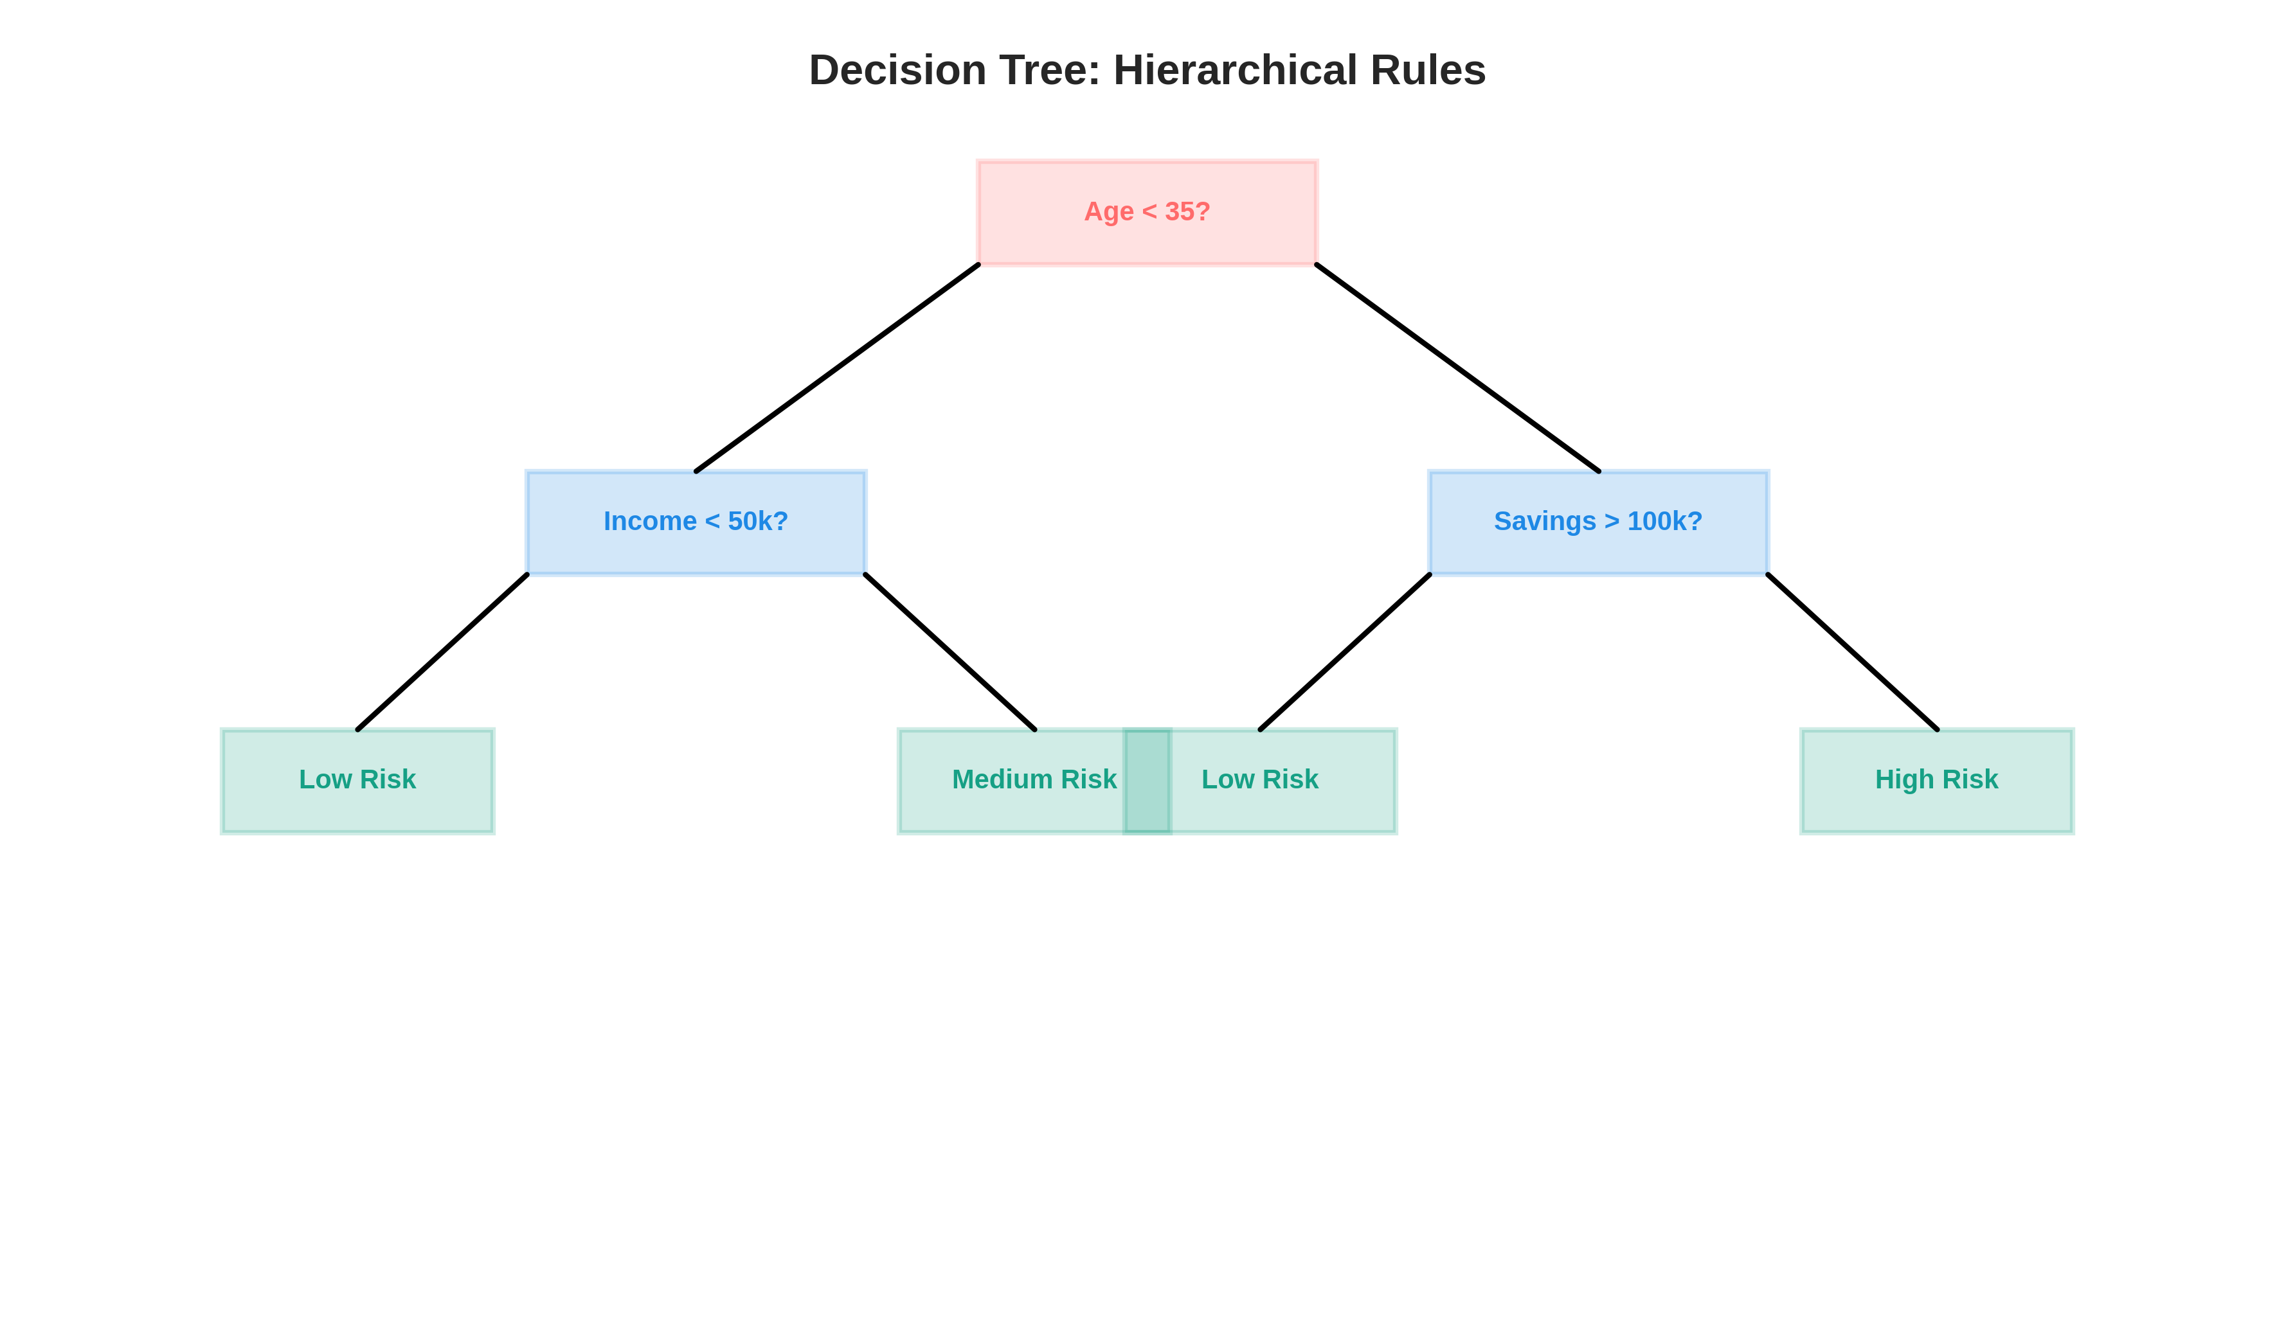
3. Decision Trees - Visual

Slide 10
3. Decision Trees - Applications
Real Use Cases
• Loan approval (banks)
• Medical diagnosis
• Customer segmentation
• Fraud detection
• Employee hiring
Pros & Cons
✓ Interpretable/explainable
✓ Non-linear
✓ No scaling needed
✗ Overfits easily
✗ Unstable (high variance)

Slide 11
3. Decision Trees - Summary
Structure: Recursive if-then-else rules
Output: Class or numeric
Interpretability: Very high (see exact path)
Training: Medium speed
Best For: Explainability + non-linear
Problem: Overfits → use Random Forest!
Code: from sklearn.tree import DecisionTreeClassifier

Slide 12
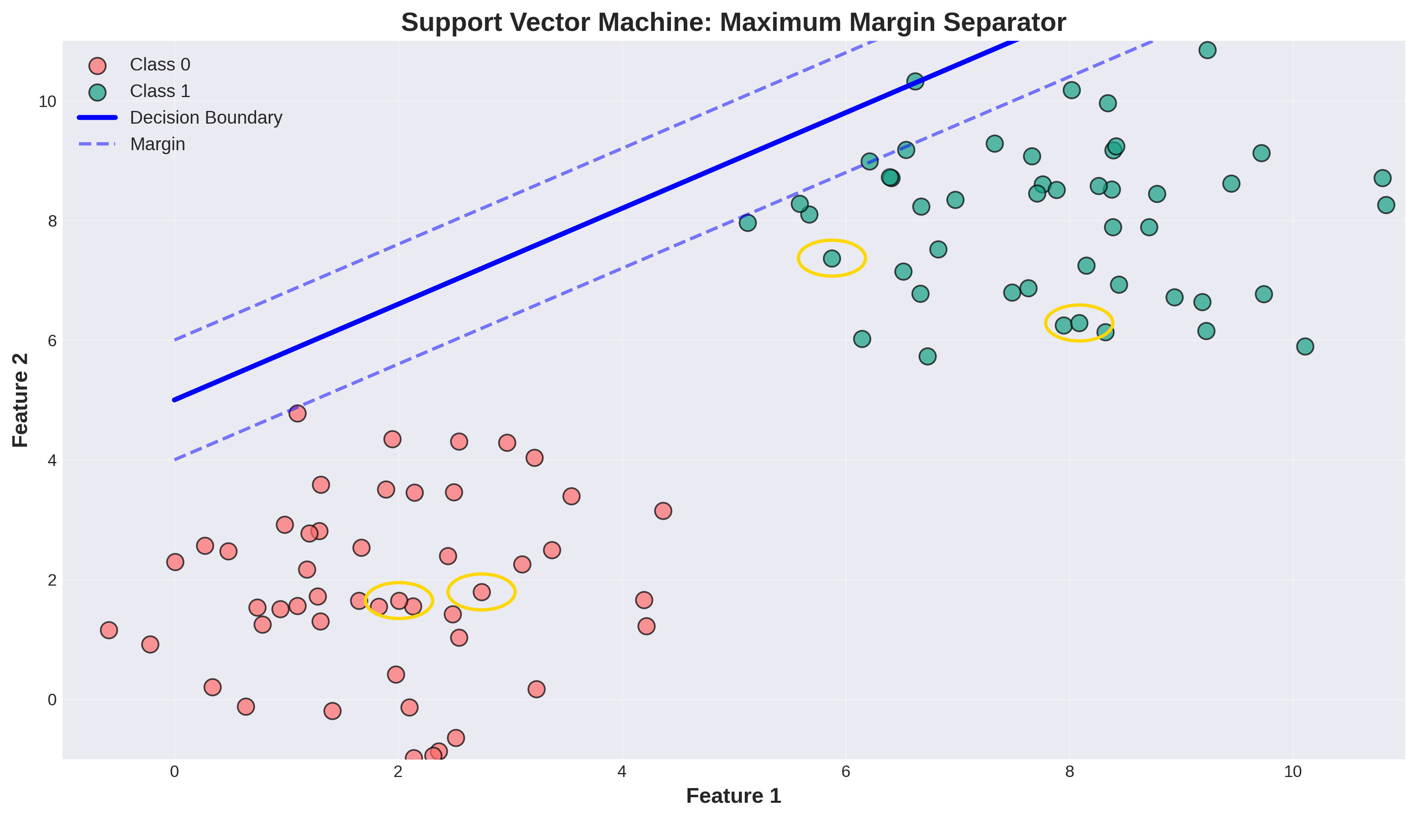
4. SVM - Visual

Slide 13
4. SVM - Applications
Real Use Cases
• Image classification
• Face detection
• Text classification
• Handwriting recognition
• Bioinformatics
Pros & Cons
✓ Works in high dimensions
✓ Flexible kernels
✓ Memory efficient
✗ Slow training (large data)
✗ Hard to interpret

Slide 14
4. SVM - Summary
Concept: Maximum margin separator
Kernels: Linear, RBF, Polynomial
Output: Class + decision function
Dimensions: Excels in high dimensions
Best For: Complex boundaries
Scaling: Requires feature scaling
Code: from sklearn.svm import SVC

Slide 15
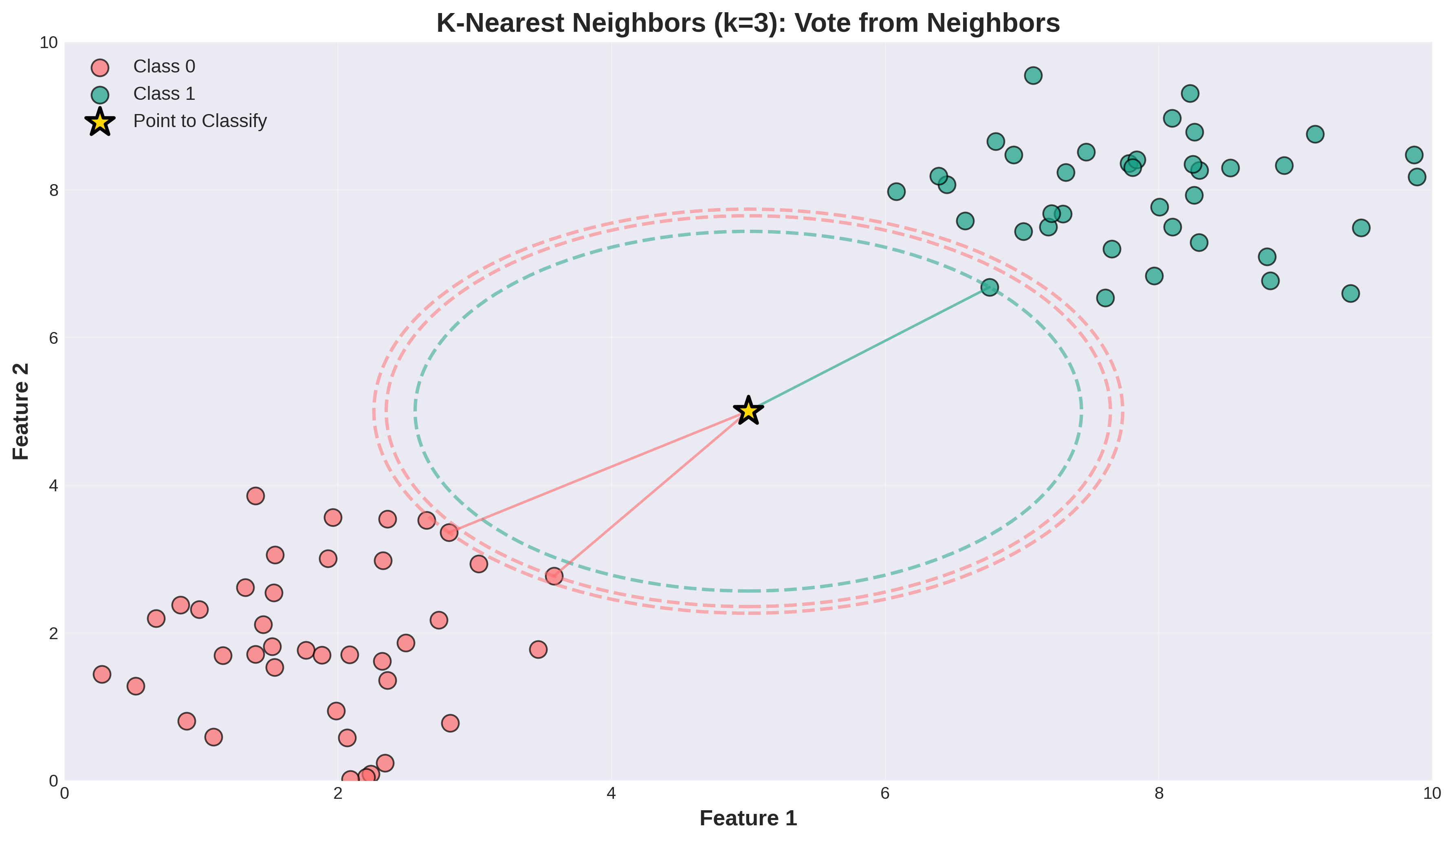
5. KNN - Visual

Slide 16
5. KNN - Applications
Real Use Cases
• Netflix recommendations
• Amazon product similarity
• Spotify music discovery
• Anomaly detection
• Image search
Pros & Cons
✓ Simple & intuitive
✓ No training needed
✓ Works with non-linear
✗ Slow prediction
✗ Memory intensive

Slide 17
5. KNN - Summary
Algorithm: Find k nearest + vote
k value: Usually 3, 5, or 7
Distance: Euclidean or Manhattan
Training: None (lazy learner)
Best For: Recommendations
Problem: Slow + memory-heavy
Code: from sklearn.neighbors import KNeighborsClassifier

Slide 18
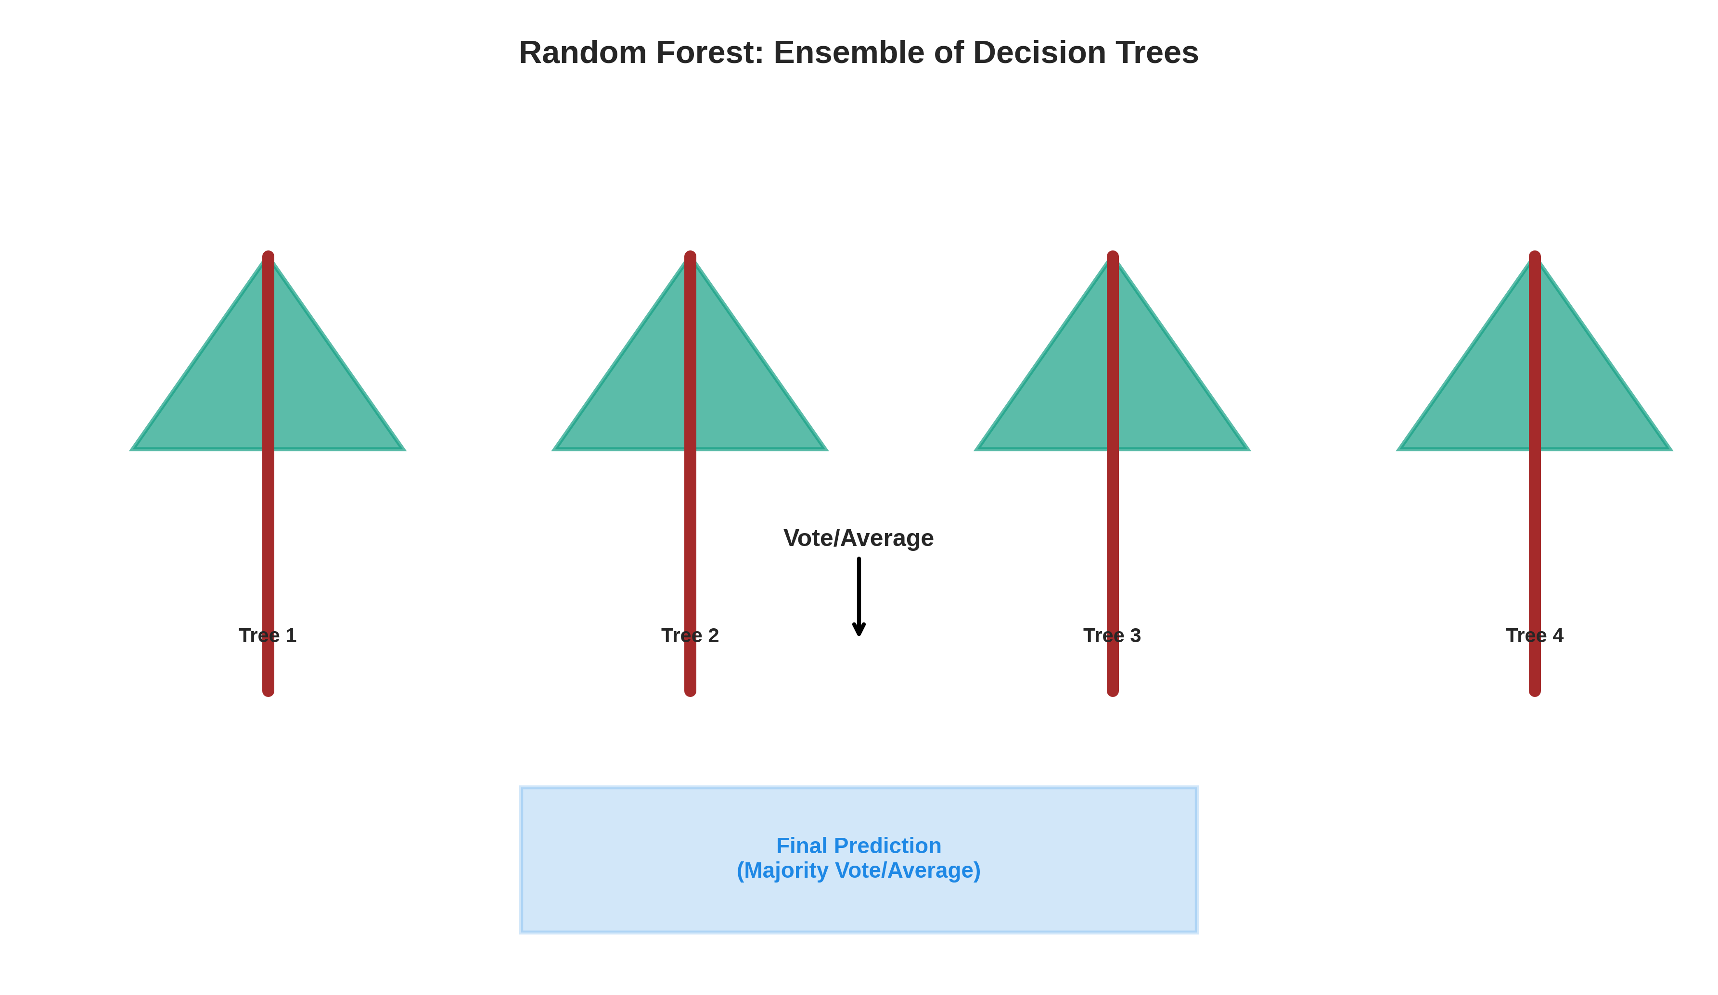
6. Random Forest - Visual

Slide 19
6. Random Forest - Applications
Real Use Cases
• Fraud detection (Visa, MC)
• Kaggle competitions
• Medical diagnosis
• Feature ranking
• Credit scoring
Pros & Cons
✓ Reduces overfitting
✓ Feature importance
✓ Very robust
✓ Industry standard
✗ Slower prediction

Slide 20
6. Random Forest - Summary
Concept: Ensemble voting of trees
Trees: Usually 100-1000
Best For: Production + robustness
Feature importance: Built-in ranking
Accuracy: Usually 85-95%
Speed: Medium (faster than SVM)
Code: from sklearn.ensemble import RandomForestClassifier

Slide 21
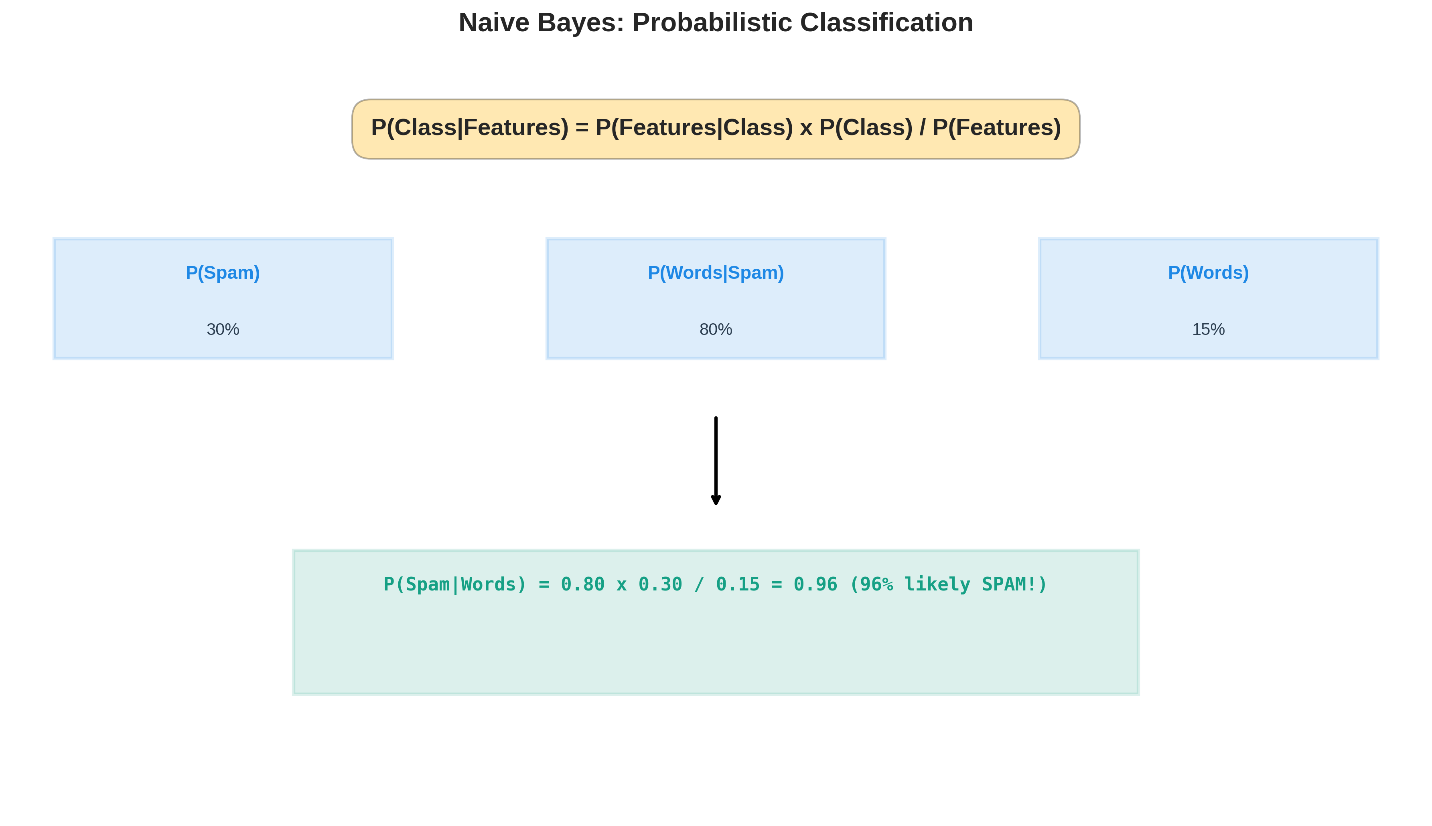
7. Naive Bayes - Visual

Slide 22
7. Naive Bayes - Applications
Real Use Cases
• Gmail spam filtering
• Twitter sentiment analysis
• Document classification
• Medical diagnosis
• Comment spam detection
Pros & Cons
✓ Very fast
✓ Works with small data
✓ Probability output
✗ Independence assumption
✗ Not state-of-the-art

Slide 23
7. Naive Bayes - Summary
Formula: P(Class|Data) = P(Data|Class) × P(Class)
Variants: Multinomial, Gaussian, Bernoulli
Speed: Very fast training
Best For: Text + small datasets
Independence: Naive assumption (works anyway!)
Interpretability: Moderate
Code: from sklearn.naive_bayes import MultinomialNB

Slide 24
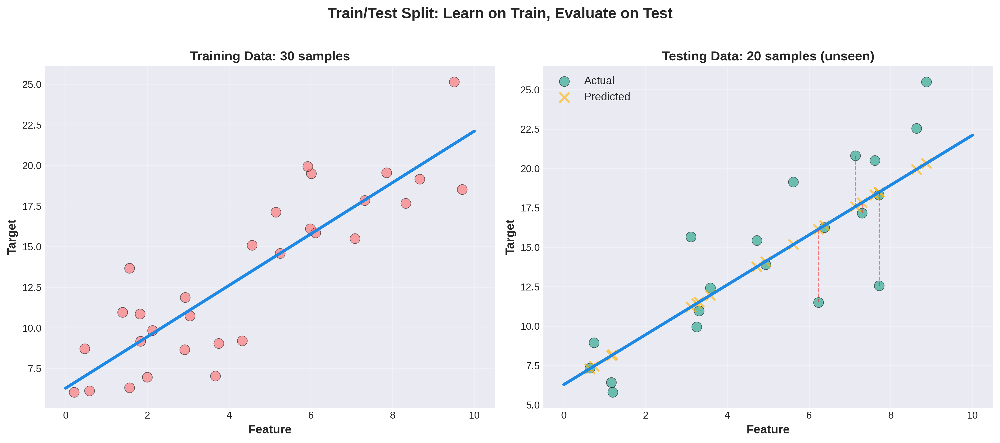
Train/Test Split - The Foundation

Slide 25
Algorithm Comparison & When to Use Each
Linear Reg → Continuous, linear → House prices
Logistic Reg → Binary, probability → Spam detection
Decision Tree → Interpretable, rules → Loan approval
SVM → Complex boundaries → Image recognition
KNN → Simple, neighbors → Recommendations
Random Forest → Robust, ensemble → Fraud detection
Naive Bayes → Fast, text → Email classification

Slide 26
Next Steps in Your ML Journey
Next: Unsupervised Learning
K-Means, Hierarchical, PCA, DBSCAN
Then: Neural Networks
Deep Learning, Backprop, CNNs, RNNs
Then: NLP
Tokenization, Word2Vec, Transformers, GPT
Then: Computer Vision
Object Detection, Image Segmentation
Then: Time Series
ARIMA, LSTM, Forecasting

